Slide 1
Original Slides

Slide 2
Customer Shipping Survey
1 = Not At All Satisfied; 5 = Completely Satisfied

Slide 3
SHIPPING DISTANCES
Distances in miles
Green warehouse is experiencing the longest order distances
Avg. 107.3 miles
Blue warehouse is experiencing the shortest shipping distances
Avg. 48.7 miles

Slide 4
Shipping Complaints

Slide 5
Redesign Slides

Slide 6

Shipping Division Update
Customer Experience
23 Oct 2020
Laura Bishop

Slide 7
Customer Shipping Survey - Methods

Slide 8
Customer Shipping Survey – All Methods
Overall Cost
Ease of Use
Shipping Notifications
Tracking Capability
Condition of Package
Delivery Speed

Slide 9
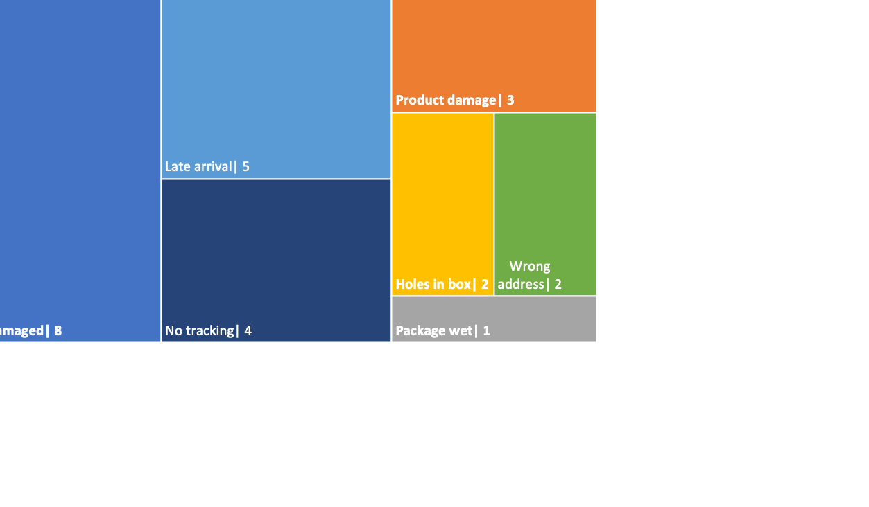
Shipping Complaints

Slide 10
SHIPPING DISTANCES for JULY 2020
GREEN WAREHOUSE
AVG 107 MILES
RED
WAREHOUSE
BLUE WAREHOUSE
AVG 49 MILES

